Slide 1
Low SNR Optimum Speech Enhancement
Edward & Timothy
I hate Papoulis (1991)

Slide 2
Types of noise contaminating speech
Additive background Noise : Uncorrelated additive noise consisting of random non-stationary/stationary signals.
Babble noise: Cocktail effect, multiple voices talking over the same speech signal.
Impulse noise: High energy, low duration signal.
Non-additive noise: changes in the spectral properties of the speech signal continuously due to varying voice intensity.
Convolutive noise: noise that is convoluted with the speech signal in the time-domain.
The focus is on the attenuation/elimination of additive background noise while still keeping perceptible quality of the processed/estimated speech signal
Additive noise
Babble noise
Impulse noise
Non-additive noise
Convolutive noise

Slide 3
Stochastic Processes
Speech and noise are naturally unpredictable.
For a given outcome 𝛇ₖ from the abstract space, there can be many realizations, or sequences that correspond to the outcome.
However, due to the unpredictability of real signals, they are termed stochastic process due to n and 𝛇 being a variable.
To clarify, an utterance or noise can be an outcome but there are many n when this outcome can occur.
A complete description of a stochastic process is hard to compute and would need a kth order joint probability distribution.
Can be averaged using second order moments
Moments are an average, statistical description of a distribution.

Slide 4
Issues with current algorithms against low SNR signals
Under low SNR many algorithms struggle to accurately estimate the noise to be subtracted leading to distortions and loss in intelligibility and perceptibility of speech.
Statistical approaches requires pre-determined criterions of the signal to perform well. If the low SNR signal correlates poorly for a given criterion then the subtracted estimated signal will result in a distorted signal.
With the discovery of DNNs (Deep neural networks), the issue of criterions could be overcome with the congregation with large number data. The DNNs are then trained on the data that fall under many criterions in order to get a ‘best fit’ of data with many criterions to encompass many input signals for more accurate estimations.
However, data is very expensive and only relying on public corpus can lead to discriminatory data training.
Currently there is evidence that this does lead to a marginal increase in performance but still suffers from the correlation issue with low SNR signals.

Slide 5
Optimum filtering issues
Optimum linear filtering has been studied extensively for many decades
The parameterisation of polluted signals has lead to the optimum filtering approach.
The correlation between the estimate and the original signal is important.
How well a signal is correlated with another signal cannot be fully mathematically described as human perception plays an important role on how well the estimate is correlated with the original signal
Due to extensive research on optimum filtering, there are many assumptions/criterions already known to work for signals falling within that criterion.
It has been proven that a well-informed statistical approach can outperform DNNs.

Slide 6
A suggested approach
We would like to suggest/test out a DNN and optimum filtering approach. The DNN will change the criterion the GMM is based on by comparing the estimated clean speech signal with the clean speech signals its trained on.

Slide 7
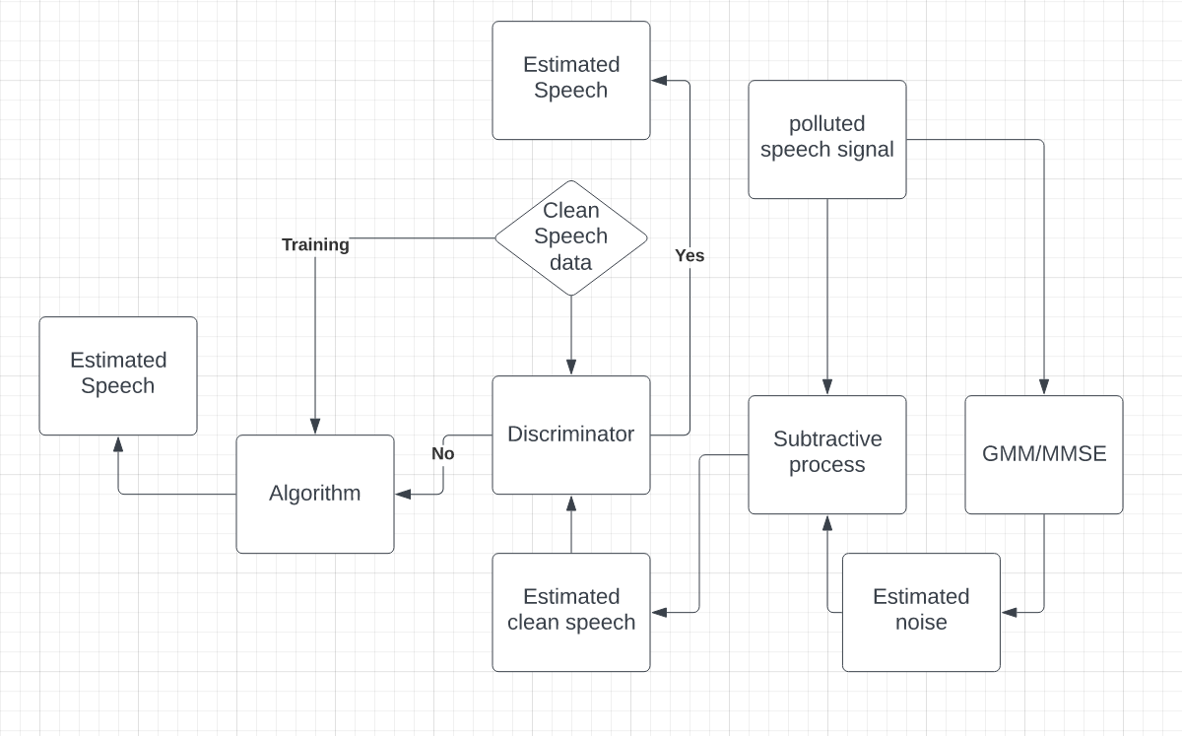

Slide 8
Method of adding GMM/MMSE with a discriminator and a ML algorithm
The rejected estimated clean sample from the discriminator is used to train the model, this allows for more data that is slightly altered to be fed into the model.
This may result in more bias in the model as it is the same data

Slide 9
Understanding of concepts so far
My notes that I think are relevant for optimum signal processing.

Slide 10
Optimum filtering
To model speech it is necessary to understand the foundation of random variables.
A random variable is a mapping that assigns a real number X to every 𝛇 outcome from an abstract probability space
Notation of random variables: for a random variable x(𝛇) = x, this means that the random variable x(𝛇) takes the specific value of x.
{x(𝛇) ≤ x} is an interval of an event in the abstract probability space for every x.
For discrete random variables x(𝛇) = {xₖ}.
A point function operates,Pr{x(𝛇) ≤ x}, on the set {x(𝛇) ≤ x}, but it is also a number that varies with x. This results in a cumulative distribution function (CDF) Fₓ(x) of a random variable x(𝛇).
From the cumulative distribution function, the probability that x(𝛇) takes the value of xₐ can be calculated
Most of this is from: Statistical and Adaptive Signal Processing, Dimitris G. Manolakis.

Slide 11
Part 2
The probability of an interval can be calculated with the probability mass function pₖ or probability distribution function fₓ(x) for continuous.
It is often hard to completely characterize a random variable as this requires the probability density function to be known. Instead moments are used to describe the average.
The expectation operator acts on a random variable and yields out the mean.
The mean µₖ is defined as Σₖ xₖpₖ when x(𝛇) is discrete.
The variance 𝝈²ₖ is defined as E([(x(𝛇)-µₖ]²)

Slide 12
GMM
Gaussian mixture modelling is a from of clustering where data is clustered into gaussian curves. It is in the form of Σₖ𝛑ₖƝ(x;𝛍ₖ,𝝈ₖ) [random variables described by the mean and variance] where 𝛑ₖ is the weight assigned to cluster K, 𝛍ₖ is the mean of cluster k and 𝝈ₖ of cluster k
These are clusters of probability density functions.
GMM initializes using the EM algorithm where data is assigned responsibilities to initial clusters with initial 𝛍 and 𝝈 (Expectation step).
When the responsibility of the data point is calculated, it is assigned to the cluster that results in a higher responsibility assigned to that data point and the 𝛍, 𝝈 and 𝛑 are recalculated for each and every data-point.
This keeps iterating until convergence where no more re-assignment/improvements can occur.

Slide 13
Understanding of MMSE so far.
MMSE generates an estimate of a signal such that the mean square error between the two signals is minimized.
The error is very dependent on how well correlated the estimated signal is to the original signal.
If the set criterion outputs a poorly correlated estimate, the error is minimal but perceptually it is large.
From my understanding, this integrates with GMM by first finding which cluster the noisy signal belongs to, and then generating an estimated noise signal for subtraction by using the data within the cluster as a reference.

Slide 14
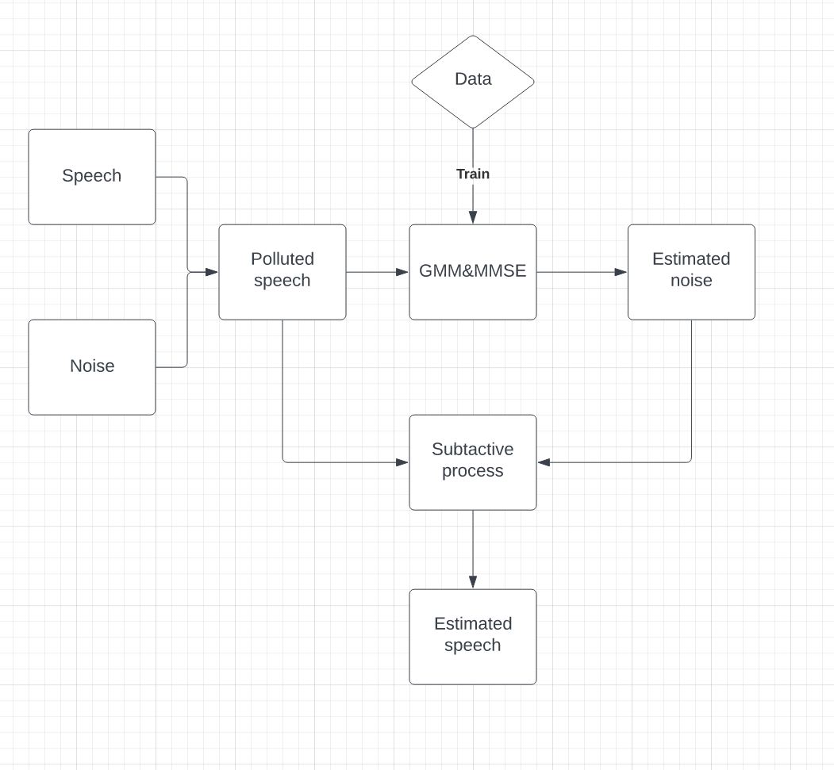

Slide 15
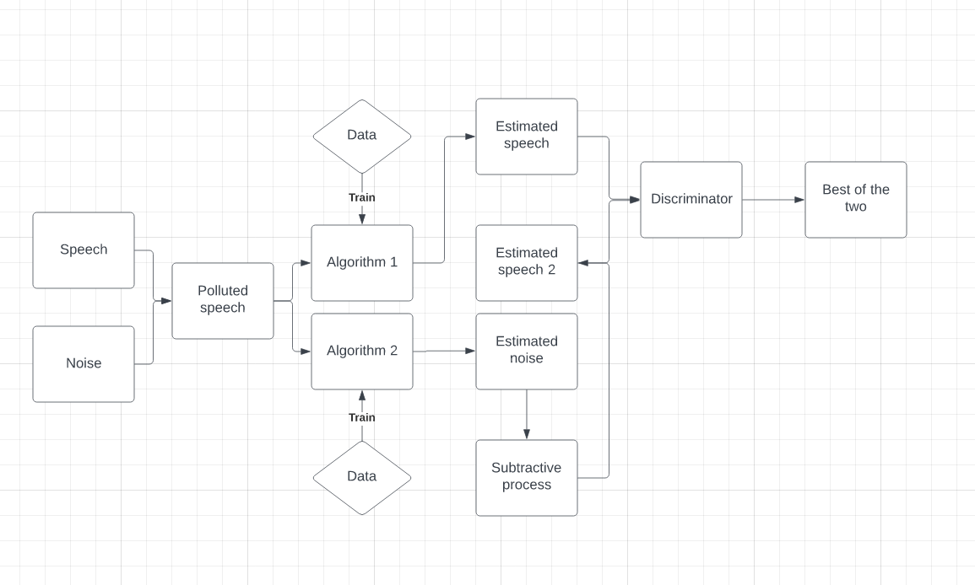

Slide 16
Dataset and setup
The dataset uses two sources the noise and speech.
With the speech and noise will be subsampled to 11.5KHz. Because most of the energy in speech is around 0 to 5 KHz.
The training samples will be mixed at different signal-to-noise ratio (SNRs)
And the testing samples will be mixed at signal-to-noise ratio (SNRs) different from the training samples
Data types
Data separation

Slide 17
Models
The Wave-U-Net method uses downsampling and upsampling blocks to make its predictions. Made for image segmentation.
Bayesian wavenet extends standard networks with posterior interference in order to control over-fitting
Both models are a pixel CNN generative model for images.
Wave-U-Net
Bayesian Wavenet

Slide 18
Parameters
Batch size : number of samples processed before the model is updated
Epoch number (learning rate) : number of compete passses through the training dataset
Out_channel: output channels
Layers
Stacks
Residual channel
Gate channel
Kernel size: size of convolution layers
States the parameters that are required for wavenet

Slide 19
Methods of improving ML speech enhancement
Combining the Wave-U-Net with the Wieners filter
Reducing the time complexity of wavenet by using non-casual and non-autoregressive architectures. But still being to predict the target field.
Testing different parameters to find which combination gives the best speech.

Slide 20
Things I need to look into
The parameters
ReLU
Softmax
ResidualConv1dGLU
non-autoregressive
How a discriminator works (is programmed)
Would need to look into these aspects.

